Slide 1
Lending Club
Case Study
By
Mangai Maharajan
Manthi Ramesh

Slide 2
Lending Club Case Study
Description :
This study is based on a consumer finance company which specializes in lending various types of loans to urban customers.
Company has to take decision to approve the loan application based on data of past loan applicants to reduce/avoid defaulters hence reduce the financial loses to the company.
Task :
Our aim is to study consumer attributes and loan attributes with the help of data from past loan applicants using EDA then identify patterns, which leads to a person is likely to default.

Slide 3
Libraries and data set used for case study :
Libraries:
Numpy
Pandas
Matplotlib.pyplot
Seaborn
Data set:
Loan.csv
Number of Rows in the Dataset= 39717
Number of Columns in the Dataset= 111

Slide 4
Manipulation of Data:
After dropping null values left out Rows = 39717, Columns = 57
After removing single valued columns, which are not useful for analysis
remaining Rows = 39717, Columns = 48
Columns such as id, member_id, url, zip_code, last_credit_pull_d, and desc do not contribute to loan risk analysis. Hence, removed these columns from the dataset.
Columns with more than 60% missing values cannot be imputed without introducing bias into our analysis. Therefore, removed these columns.
Final shape of the data set is 39717 rows and 26 columns.

Slide 5
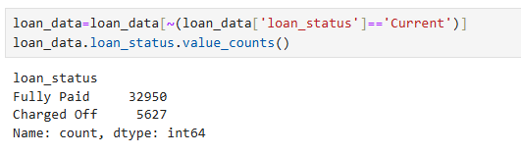
Filtering Loan Status for Analysis:
The objective of this analysis is to determine the likelihood of loan default. This can only be assessed for loans that are either fully paid or charged off. Current loans cannot provide meaningful insights into default risk. Therefore, we excluded records with a current loan status from our dataset.

Slide 6
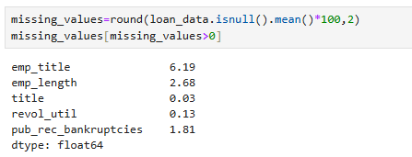
Checking and Imputing Missing Values:
To ensure the quality of our data, we need to identify and handle missing values appropriately.
Imputing missing values helps maintain the integrity of the dataset without introducing bias.
Imputed missing values with Mode to maintain integrity of data set.

Slide 7
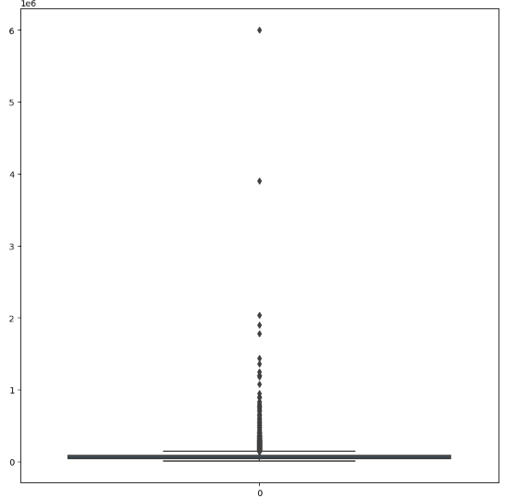
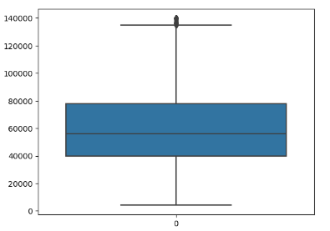
Outlier Detection and Removal Using Boxplots :
Annual Income Box Plot at 100%
Annual Income Box Plot at 95% quantile

Slide 8
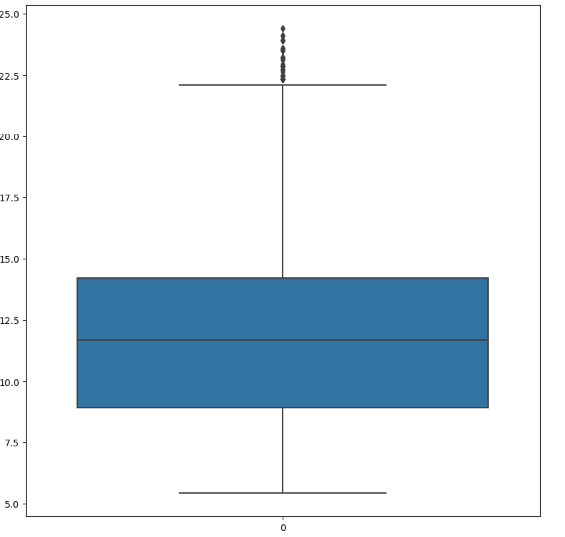
Interest Rate Box Plot

Slide 9
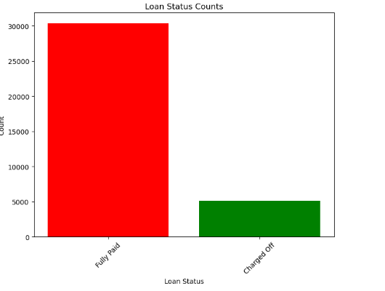
Bar Plot of Loan Status
85.5%
Percentage of customers fully paid =85.5
Percentage of customers Charged off =14.5
14.5%

Slide 10
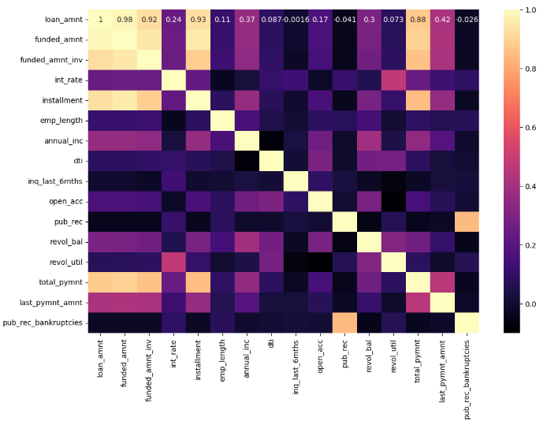
Heat Map

Slide 11
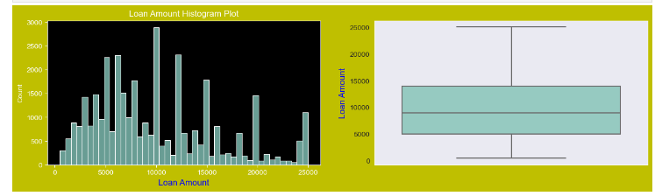
Univariate Analysis
Loan Amount Histogram and Box Plot
Observations : The majority of loan amounts fall within the range of 5000 to 15000

Slide 12
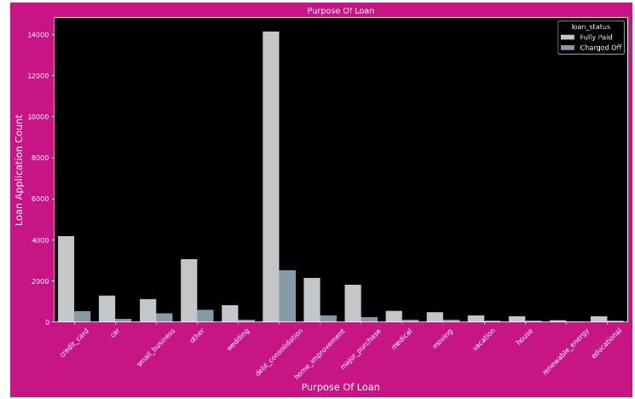
Histogram Plot for Purpose of Loan
Observations :
The count plot shows that debt consolidation accounted for the majority of loans taken out. Furthermore, a very high number of loans that have been charged off are connected to these uses.

Slide 13
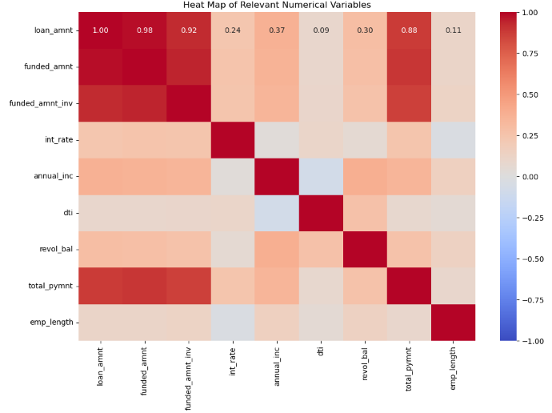
Bivariate Analysis
Heat Map

Slide 14
Observations
Loan amount, funding amount, and funded amount invested are strongly correlated: These three variables are closely related, indicating that as one increases, the others tend to increase as well.
Interest rate and employee length are negatively correlated: This suggests that longer employee tenure is associated with lower interest rates, possibly reflecting lower risk for long-term employed individuals.
Delinquency in the past 2 years and inquiries in the last 6 months are positively correlated with the interest rate: This suggests a tendency towards higher interest rates for borrowers with recent delinquencies and numerous recent credit inquiries, indicating a higher risk of default.
Annual income is positively correlated with loan amount, revol_bal, and total payment: Higher income individuals tend to take out larger loans, have higher revolving balances, and make higher total payments.
Debt-to-income (DTI) ratio is positively correlated with revolving balance: This indicates that individuals with higher revolving balances tend to have higher debt-to-income ratios.
Total payment is strongly correlated with loan amount, funded amount, and funded amount invested: This shows that larger loans lead to higher total payments over time.

Slide 15
Bi variate Analysis, Part One with loan status
In this section, we will compare the loan status to certain important columns that might have an impact on debts that have been charged off.
LOAN AMOUNT
INTEREST RATE
ANNUAL INCOME
PURPOSE OF LOAN
GRADE
SUB GRADE
EMP LENGTH (EMPLOYEE EXPERIENCE)
DTI
HOME OWNERSHIP
VERIFICATION STATUS
ADDRESS STATE
PUB_REC_BANKRUPTICIES (BANKRUPTICIES)

Slide 16
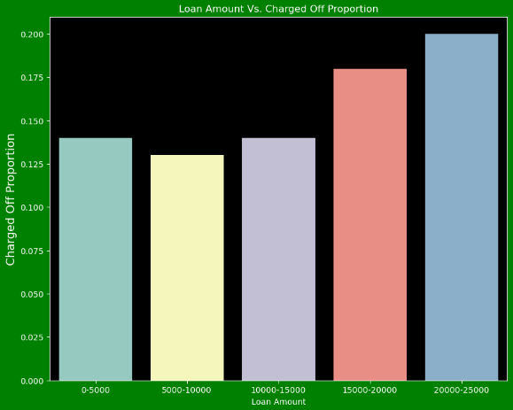
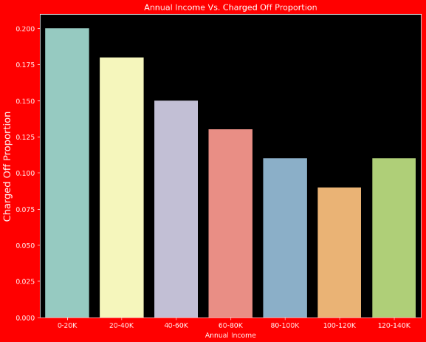
Bi variate Analysis, Part One with loan status
Loan Amount Vs Charged off Proportion
Annual Income Vs Charged off Proportion

Slide 17
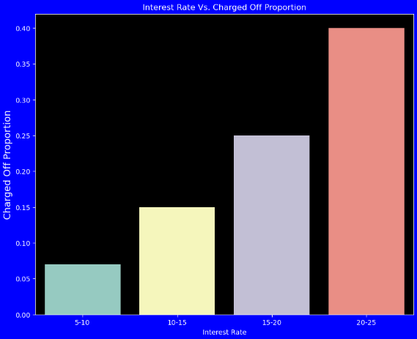
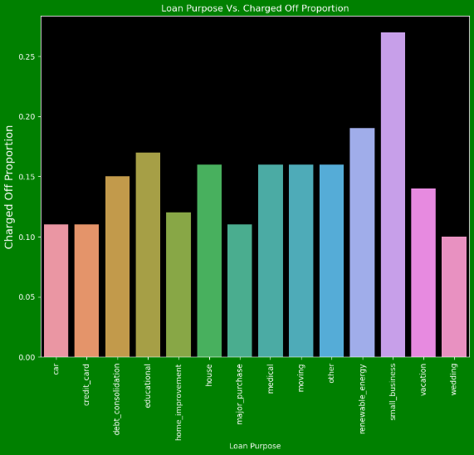
Bi variate Analysis, Part One with loan status
Interest Rate Vs Charged off Proportion
Loan Purpose Vs Charged off Proportion

Slide 18
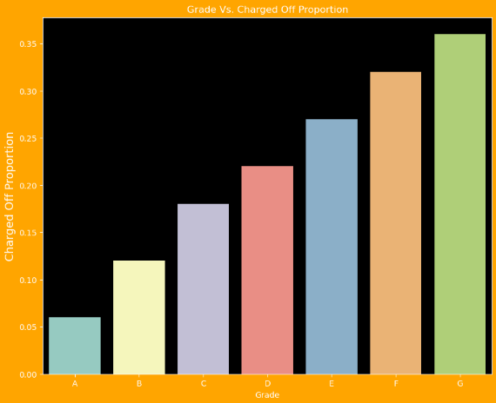
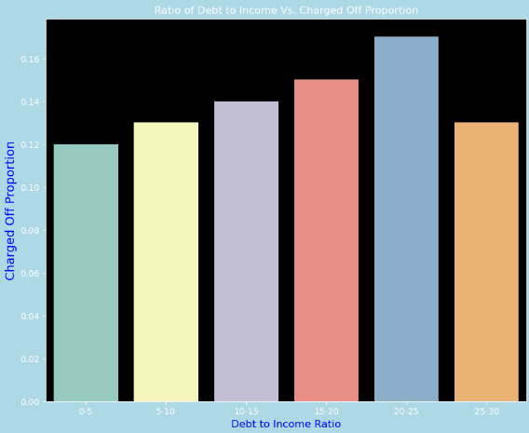
Bi variate Analysis, Part One with loan status
Grade Vs Charged off Proportion
Debt to Income Ratio Vs Charged off Proportion

Slide 19
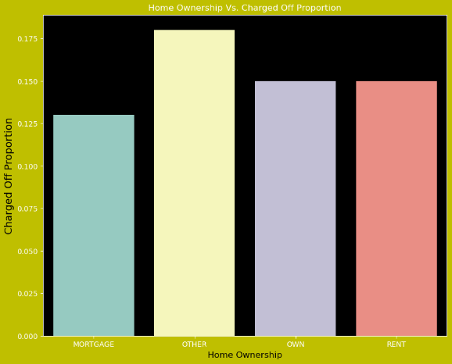
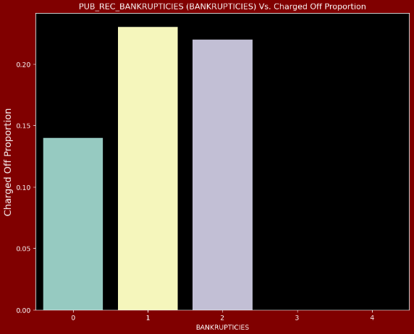
Bi variate Analysis, Part One with loan status
Home Ownership Vs Charged off Proportion
Bankruptcies Vs Charged off Proportion

Slide 20
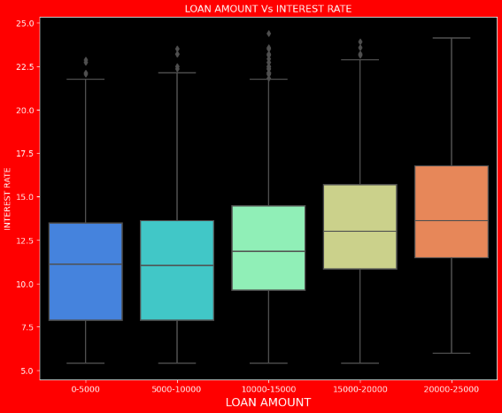
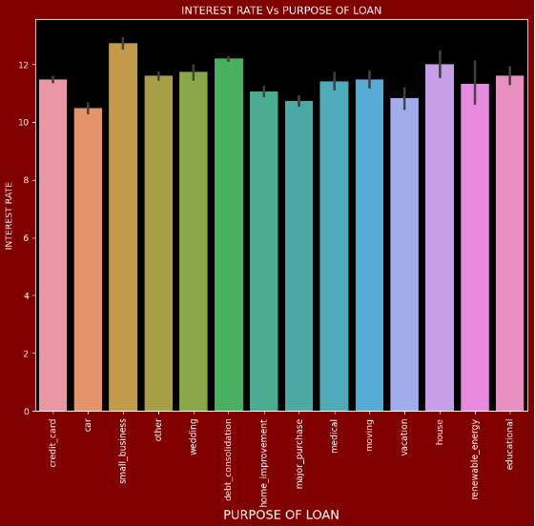
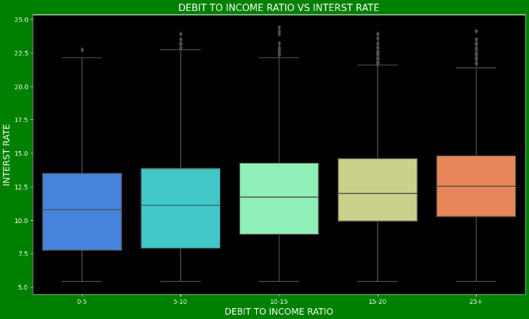
Bi variate Analysis with Two Different components, Part Two
Loan Amount Vs Rate of Interest
Loan Purpose Vs Rate of Interest
Debt to Income Vs Rate of Interest

Slide 21
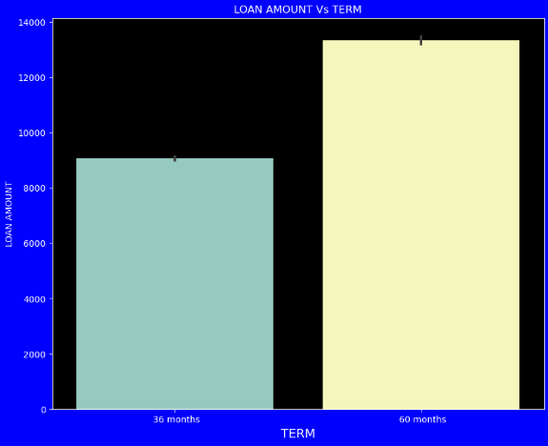
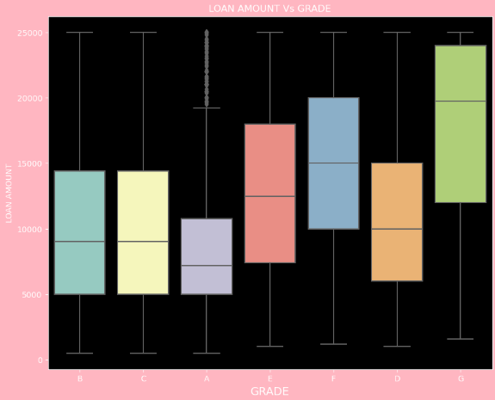
Bi variate Analysis with Two Different components, Part Two
Loan Amount Vs Term
Loan Amount Vs Grade

Slide 22
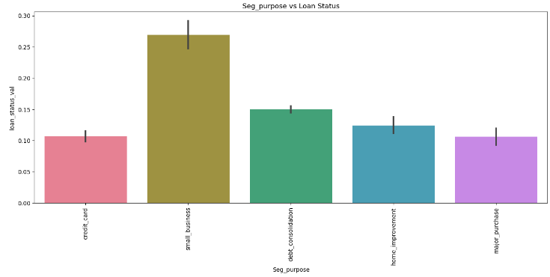
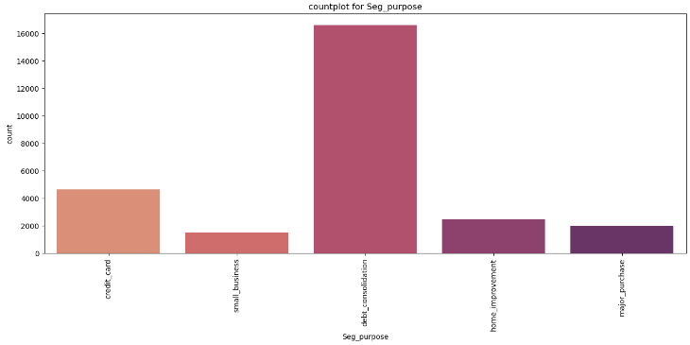
Segmented Analysis
Purpose Vs Loan Status
Count plot for Seg_Purpose

Slide 23
Conclusion
Loans with higher loan amount, higher interest rate, Grade F and Grade G are more likely to be charged off.
Small business loans are at a higher proportion of charged off loans.
Those who are unemployed or have less than one year of experience are more likely to be charged off.
The likelihood of a loan being charged off increases progressively as DTI increases.
Those with pub_rec_bankruptcies values 1 and 2 have higher charged-off percentage than those without pub_rec_bankruptcies.
It's clear that as annual income increases, the percentage of charged-off loans decreases.

